Slide 1
What do you already know?
Earlier in May I posted on twitter the idea of building on discussion practices like What do you notice? What do you wonder? And How many? To asking students What do you already know? (that could help you solve this problem). This question shifts the focus from the solution and how you get there, to drawing on and discussion prior knowledge. We often hope students will use prior knowledge to solve new and unfamiliar tasks but they don’t always do this, or they do but don’t know they’ve made a connection. The aim of these problems is to focus on what prior knowledge students are bringing and using to solve the task and what are the key concepts that are being addressed. The answer is not important.
I have added some ideas of what students may suggest or concepts they mention in the notes section.
Katherin

Slide 2
What do you already know?
(That could help you work out how many?)
Notes:
Students may identify:
Estimating – visually estimate at least 50
Partitioning – you can break large collections into smaller parts to add them (in this case by colour)
Skip counting – counting in ‘clumps’ or even twos may help
Arrays – it is in a row and column structure (two rows, easier to use the right column to estimate how many then double)
Benchmarks – I can see about 4 or 5 blues ones, I can use this to work out the other amounts

Slide 3
What do you already know?
17 + 13 = 🔲 + 14
(That could help you work out what to put in the box?)
Notes:
Equals means the same as so both sides should equal 20
Twenty can be made up of combinations of 2 numbers
Both sides have to equal the same
I can see ‘tens’ or combinations of ten inside the numbers that can help me
14 is one more than 14 so the number is box should be one less than 17

Slide 4
What do you already know?
17 + 13 = 🔲 + 🔲
(That could help you work out what to put in the boxes?)
Notes:
Equals means the same as so both sides should equal 20
Twenty can be made up of combinations of 2 numbers
Both sides have to equal the same
I can see ‘tens’ or combinations of ten inside the numbers that can help me
There are many of different solutions
I could use patterns to help work out some solutions, 1 + 19, then 2 + 18

Slide 5
What do you already know?
(That could help you work out clever ways to count the stars?)
Downton & Wright, 2016
Notes:
Image from Ann Downton and Vince Wright’s research paper “A rich assessment task as a window into students’ multiplicative reasoning” (2016) https://files.eric.ed.gov/fulltext/ED572399.pdf
The stars are in rows and columns
I can break the shape up into smaller shapes like rectangles
I can use area to help count some of the stars by multiplying their length and width
I can use multiplication to count some of the stars
I can use skip counting by rows
I will need to use addition and maybe subtraction to work out the total (and take away the part in the middle)

Slide 6
What do you already know?
1
20
(That could help you work out what what numbers to put in the boxes?)
Notes:
Inspired by the chat/ post at https://twitter.com/AMSIschools/status/1130327045215383552
I could use what I know about half of 20
I could mark out where all the numbers should go between 1 and 20
Think about what numbers they can’t be
Count by ones (skip or jump)
Visualise where the other markers go

Slide 7
What do you already know?
30
(That could help you work out what what numbers to put in the boxes?)
Notes:
Inspired by the chat/ post at https://twitter.com/AMSIschools/status/1130327045215383552
I could use what I know about half of 30
I could mark out where all the numbers should go between 1 and 30
Think about what numbers they can’t be
Count by ones (skip or jump)
Visualise where the other markers go

Slide 8
What do you already know?
10
100
(That could help you work out what what numbers to put in the boxes?)
Notes:
Inspired by the chat/ post at https://twitter.com/AMSIschools/status/1130327045215383552
I could use what I know about half of 100
I could mark out where all the numbers should go between 1 and 100
Think about what numbers they can’t be
Count by ones (skip or jump)
Visualise where the other markers go

Slide 9
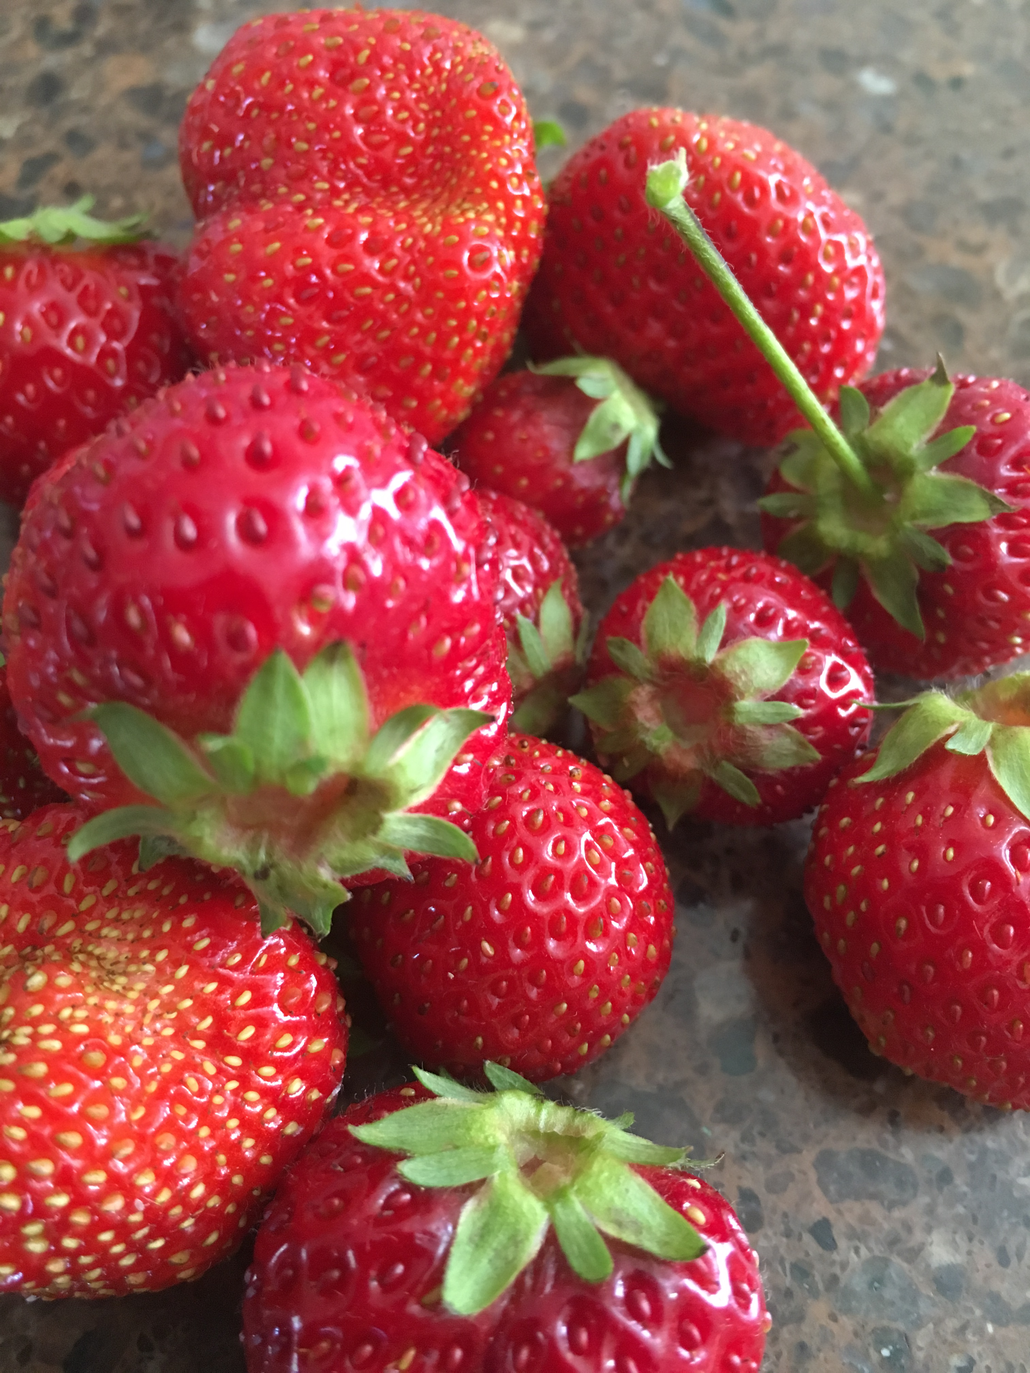
What do you know already?
(That could help you work out which picture has more strawberries?)
Notes:
I know how to count by ones
I know that the size of the object doesn’t matter when counting
I know that I can estimate (more than 10)
I could look for pairs, or count by twos

Slide 10
What do you already know?
63 $÷$ 3 =
(That could help you work out how to solve this question?)
Notes:
Knowledge of dividing by three is the same as making thirds
Place Value / Partitioning 63 into 60 and 3 to then get 20 and 1 21
Easier to split the 63 into thirds than to count by 3s

Slide 11
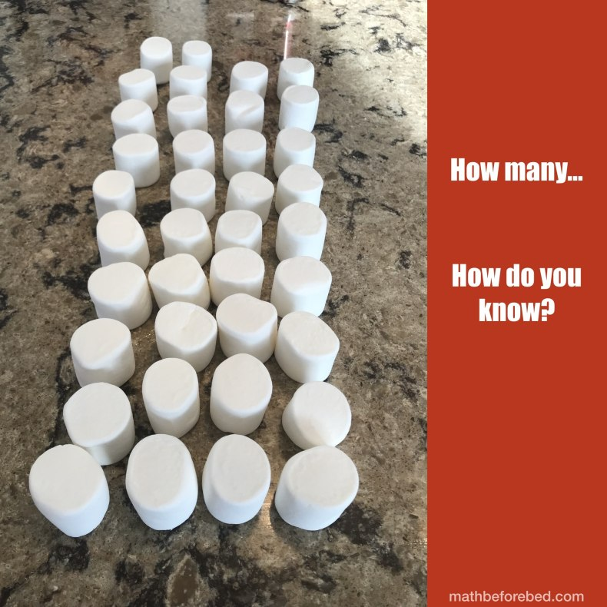
What do you already know?
(That could help you work out how many?)
https://mathbeforebed.com/2019/02/21/marshmallows/
Notes:
Image from Math Before Bed
I can use arrays to work it out
I can count by 4s or by 10s
I can count by 2s
I can estimate or count half then double
It’s rectangle, so I can multiple the two side amounts to get the solution
It’s like working out area

Slide 12
What do you already know?
16 x 8 =
(That could help you work out how to solve this question?)
Notes:
I know I can break (partition) 16 into 10 and 6
I know I can do 16 x 2 (double 16) then double again, then double again
I know I can use repeated addition 16 + 16 + … (Note: this is a very inefficient strategy but students may still suggest it)
I can use halving and doubling e.g. 32 x 4 it’s easy to use having and doubling when both numbers are even, I could do it twice to get 64 x 2
The answer will be even as both numbers being multiplied are even
This is the same as 8 x 16 (commutative property)
I could use compensation and do 16 x 10 then take away 32

Slide 13
What do you already know?
3001 – 2980 =
(That could help you work out how to solve this question?)
Notes:
I can use addition to solve subtraction tasks
It’s more efficient to count up or count down by ones for this question where the numbers are very close together
These numbers are close on a number line
I know if I add 20 to 2980 I get to 3000 then it’s just one more
3001 is larger than 2980
The difference will be small as 2900s are close to 3000
I can change the numbers to make the problem easier, I can take 1 off both numbers (the difference will still be the same) e.g. 3000 - 2979

Slide 14
What do you already know?
25 x 50 =
(That could help you work out how to solve this question?)
Notes:
I can solve simpler problems to find the solution e.g. 25 x 5 is 125 then multiple that by ten (increase place value) to get 1250
I can flexibly change the numbers to help with the solution:
See the problem as 250 x 5 instead
Use doubling (one number) then halving the answer method 25 x 100 then halve the answer
Partition 25 into 20 and 5 then solve the problem as 20 x 50 and 5 x 50
Use area model to draw a diagram to help work out the answer (partitioning both numbers into their tens and ones)

Slide 15
What do you already know?
(That could help you work out how many?)
Notes:
Image is of one of the cards in the Tiny Polka Dots game pack https://tinypolkadot.com/
I know numbers patterns on a dice
I can see twos and fours
They are in a 3 by 3 array (or 3 rows of 3)
There are 6 twos
There are 3 fours
Each column is the same
There is a pattern across each row – two, four, two …
I can use addition to add the numbers
I can use skip counting to count the twos and fours
I could add the 3 numbers across the add that twice more

