Slide 1
Noticing and Wondering 2
These are a collection of images (all my own) that can be used as discussion starters in your mathematics classroom. When students make statements about what they notice and pose questions about what they wonder it engages them in mathematical thinking and reasoning.
For more information on Noticing and Wondering Max Rey and Annie Fetter from The Math Forum are worth checking out.
Jerry Burkhart has a nice blog about noticing and wondering as does Mark Chubb.
For further images I recommend Daily Overview or Number Talk Images or your own!
Katherin

Slide 2
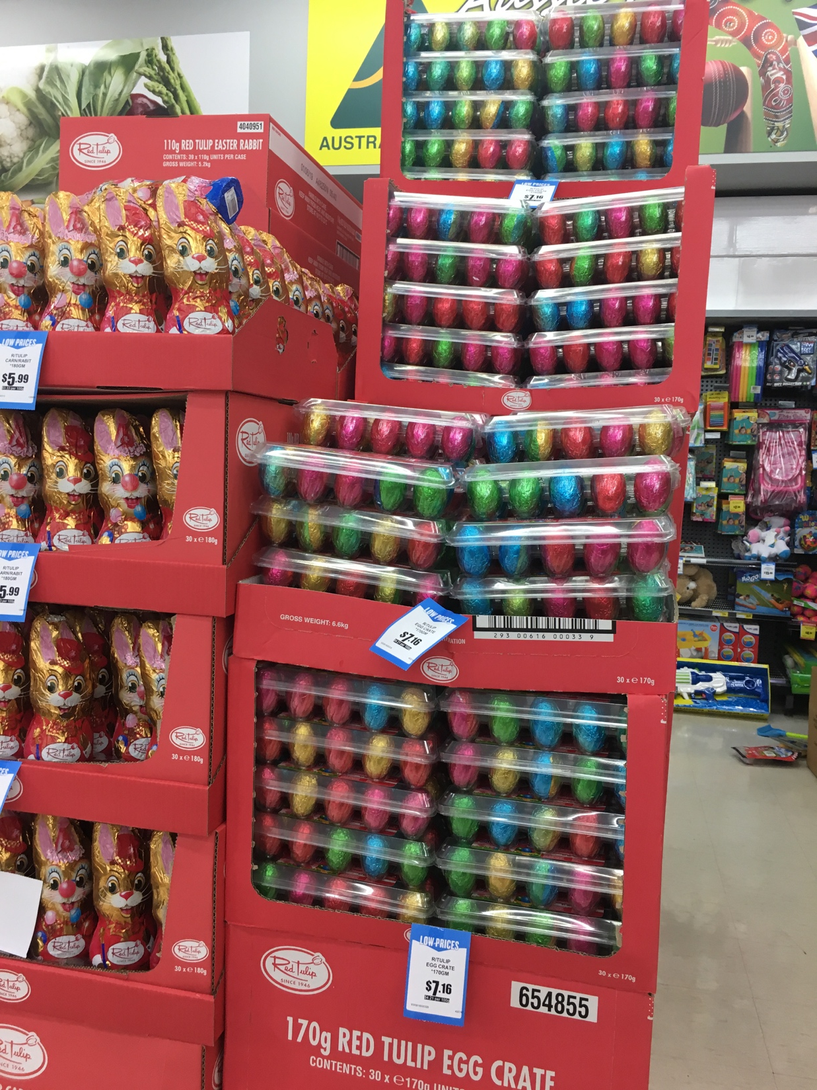

Slide 3
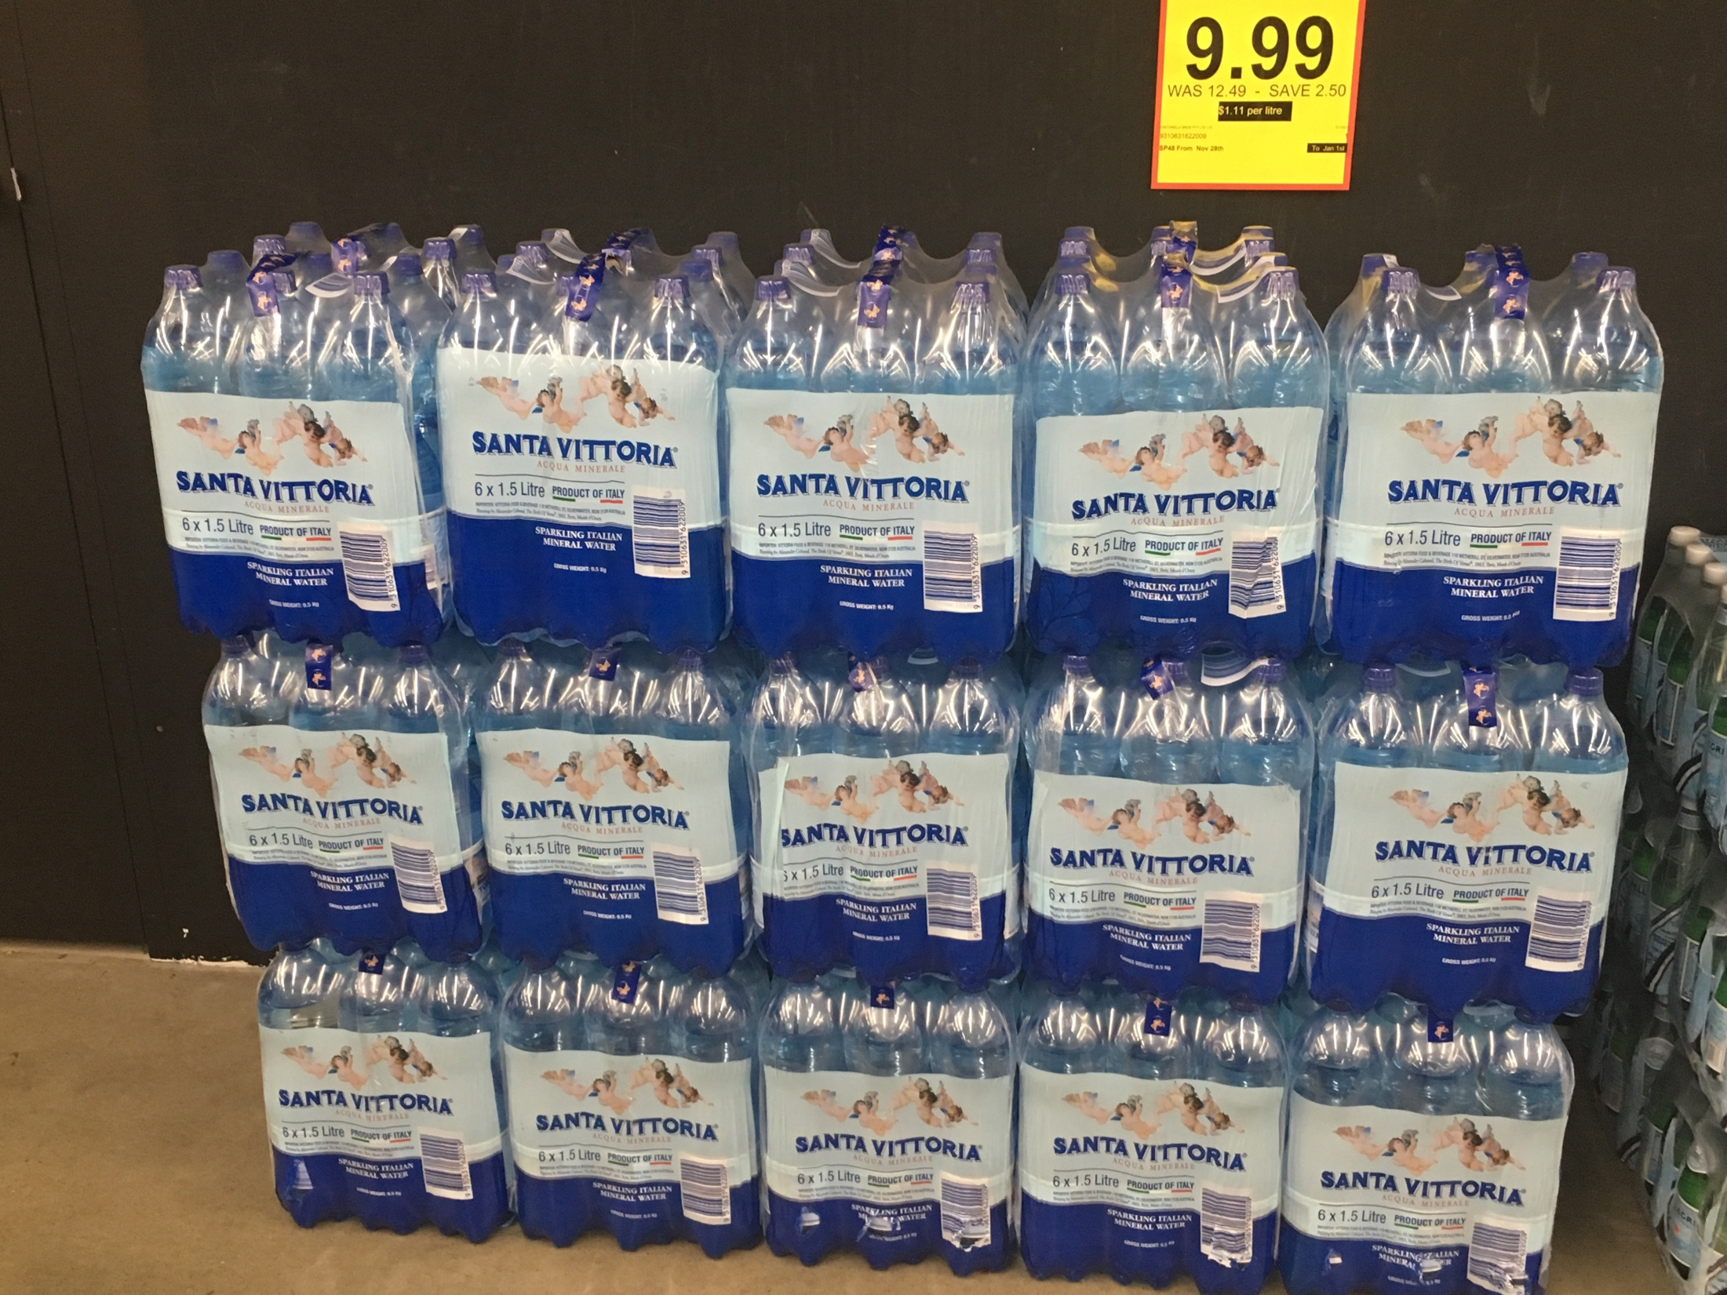

Slide 4
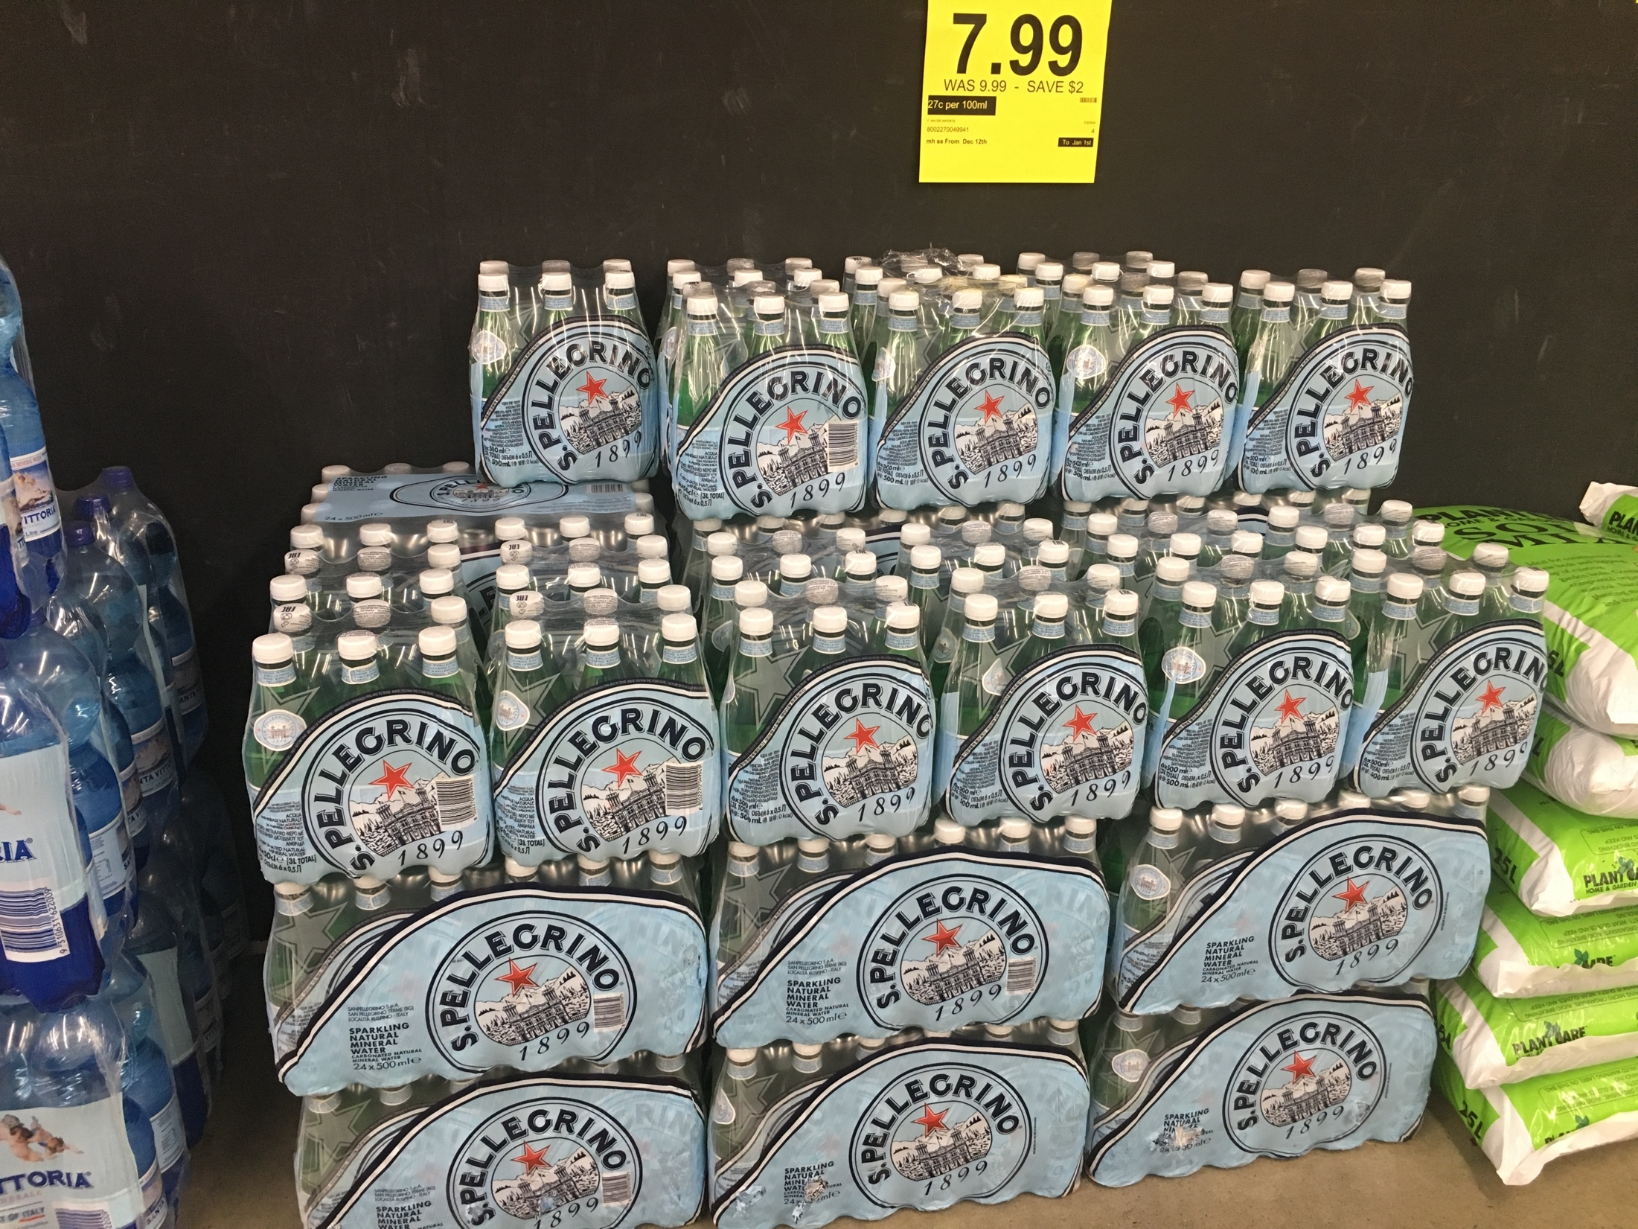

Slide 5
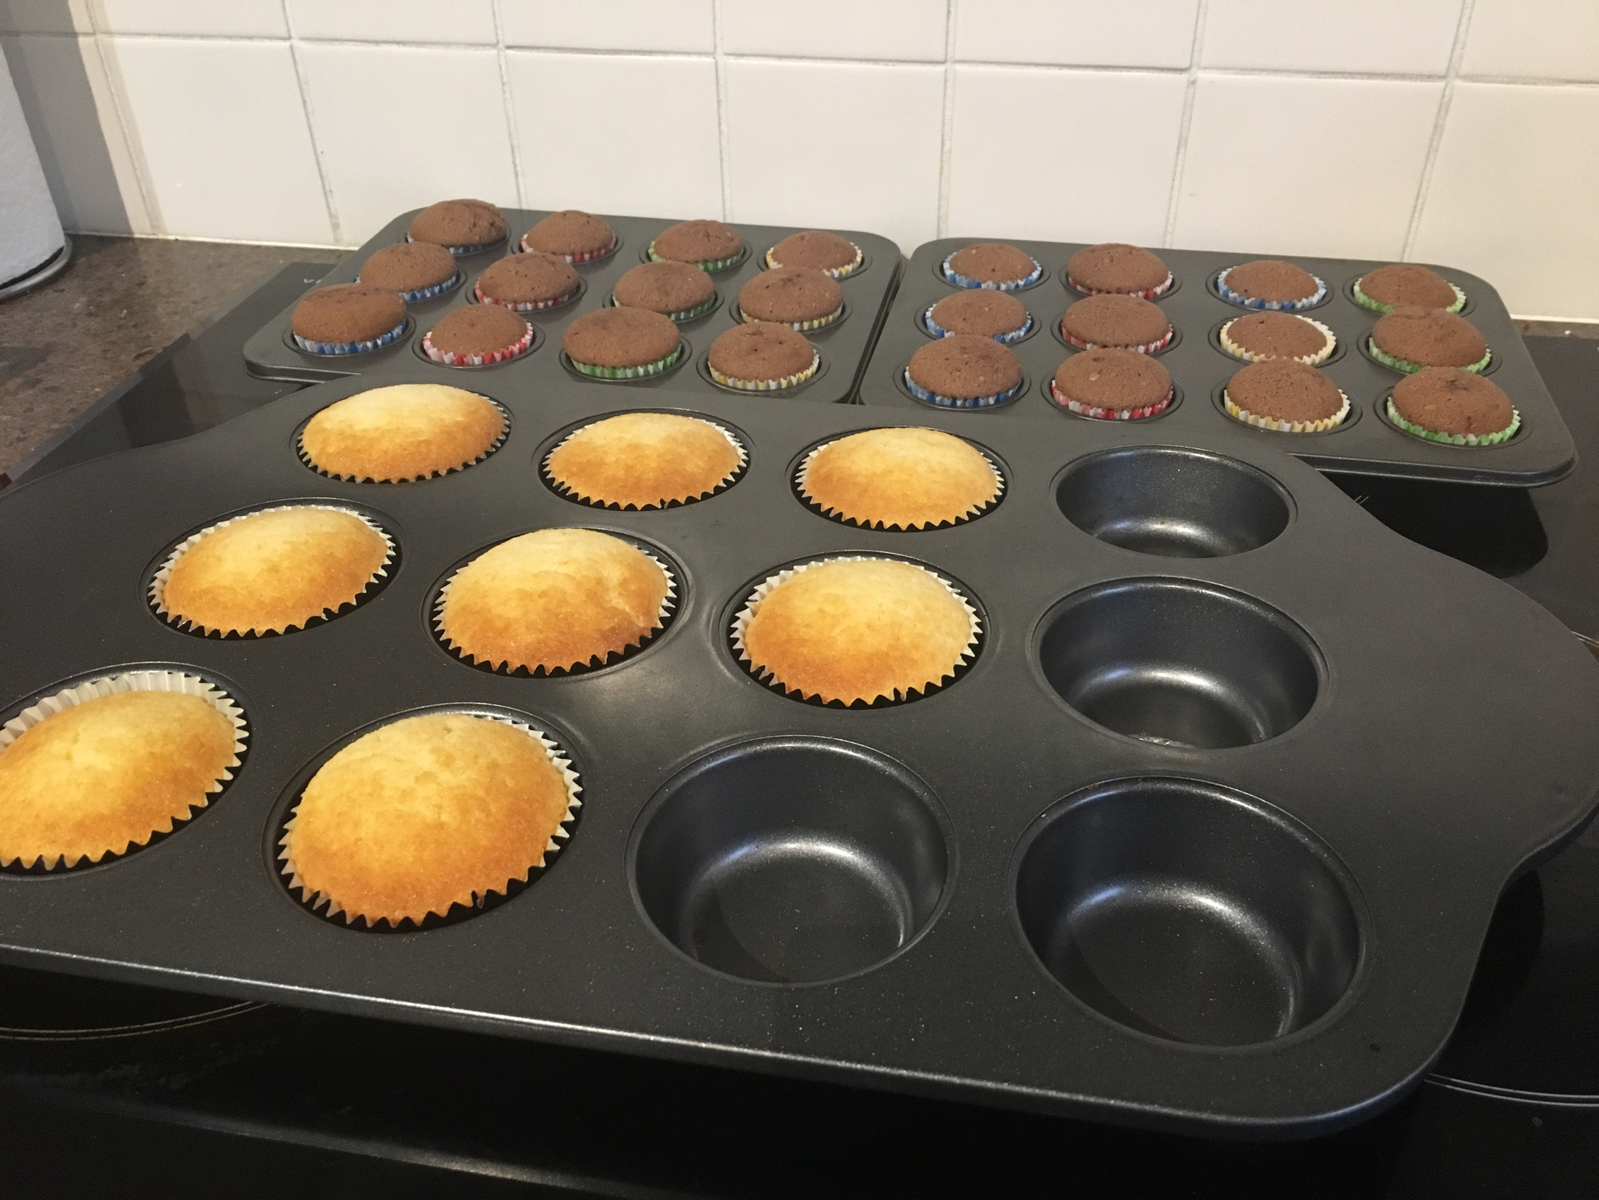

Slide 6
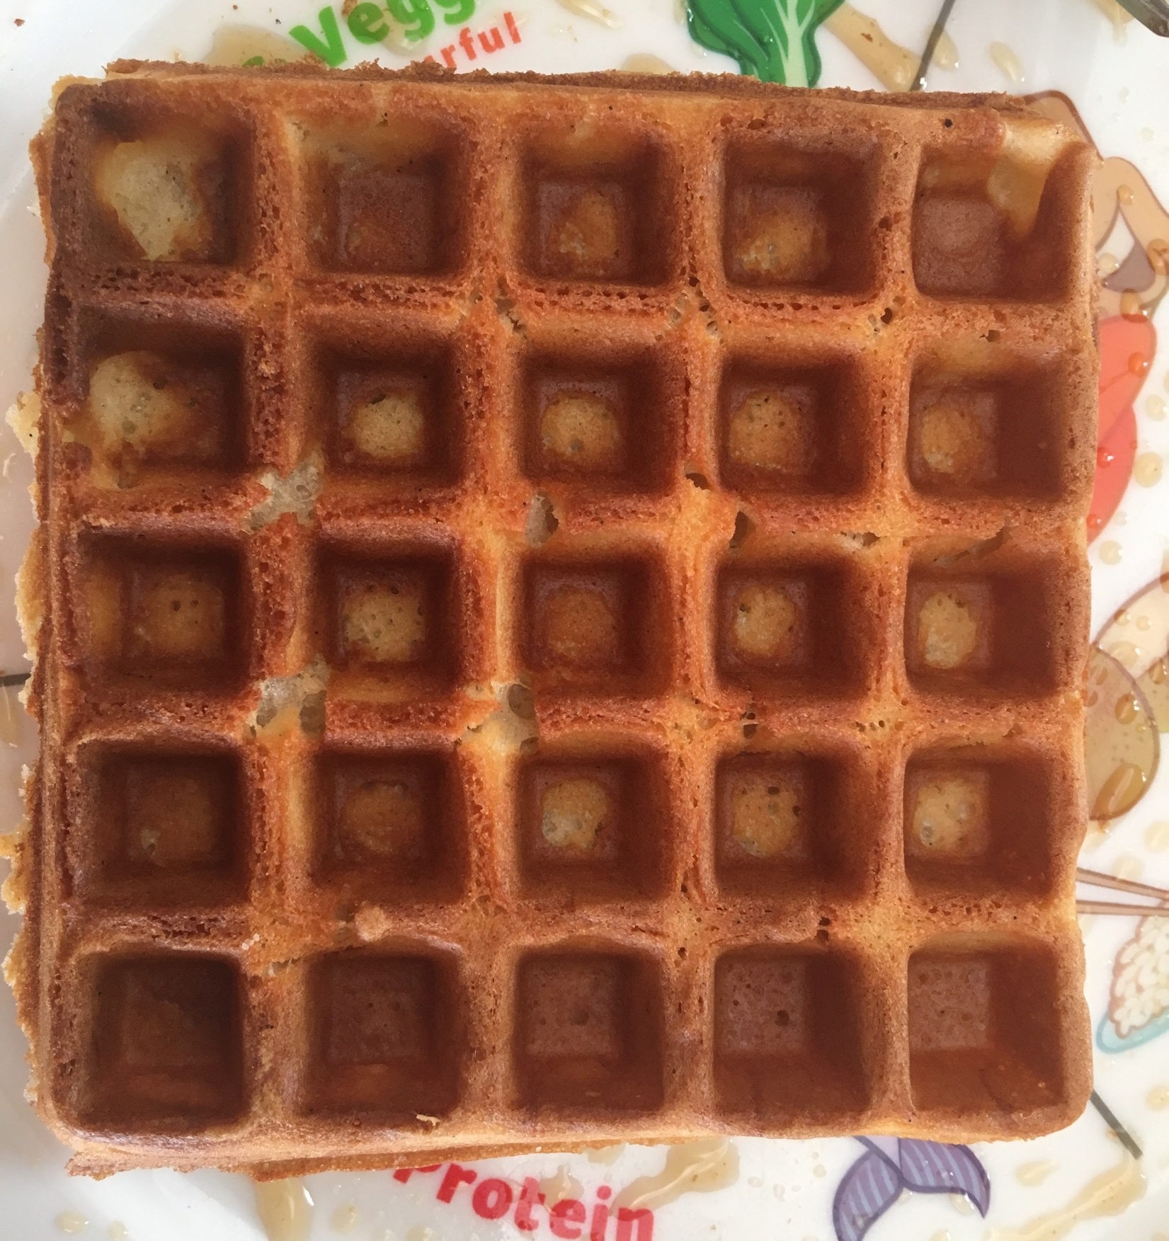

Slide 7
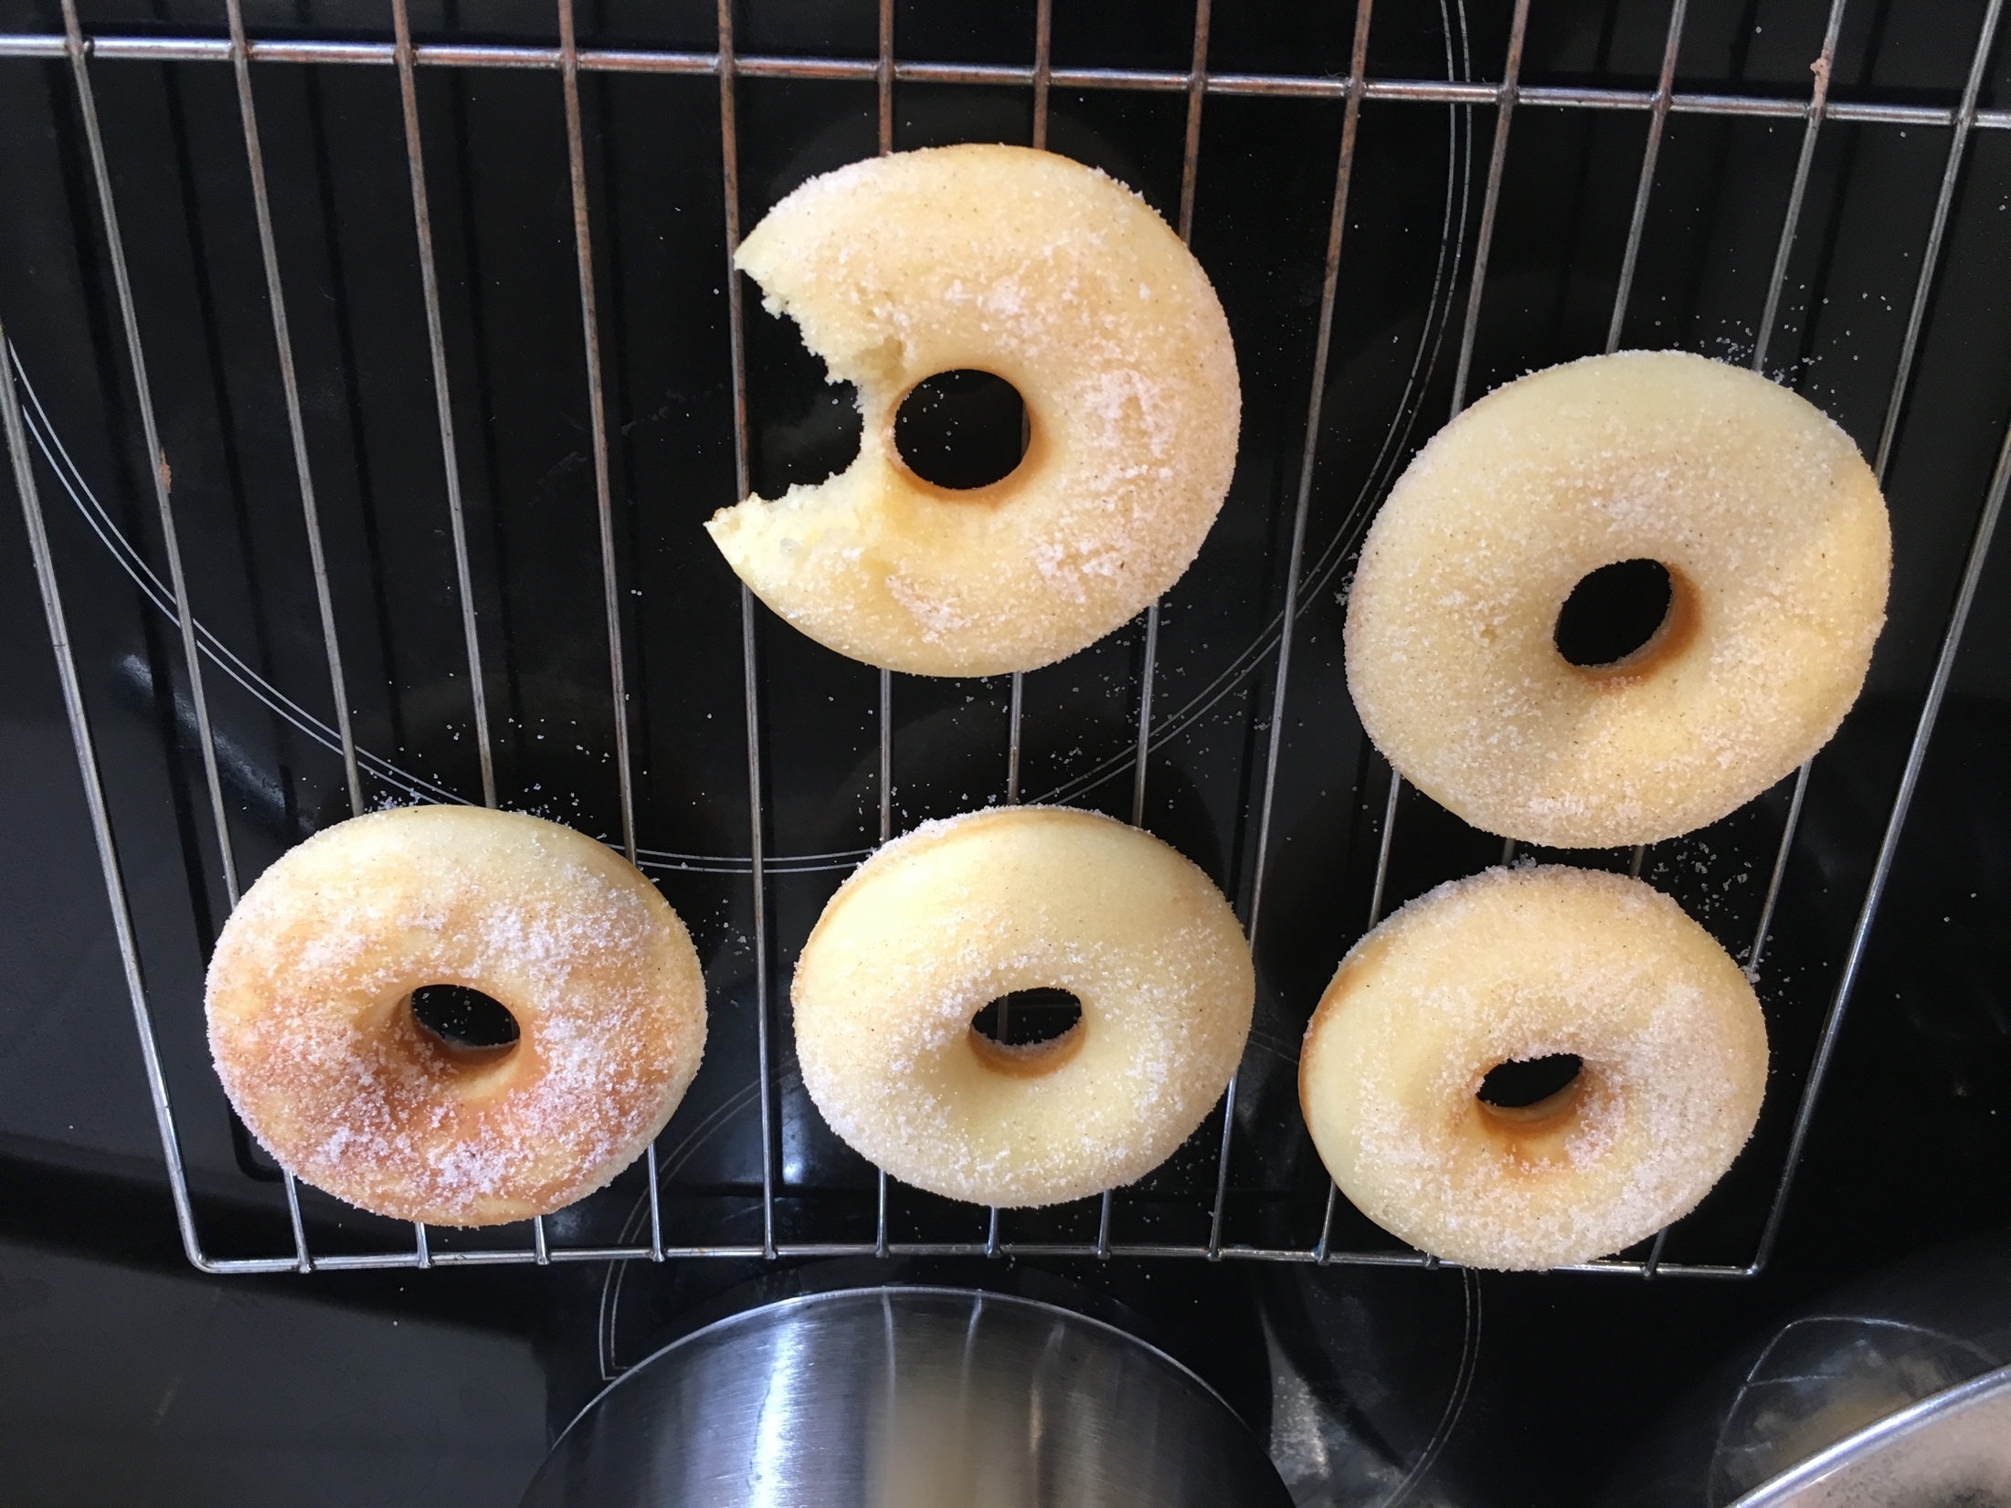

Slide 8
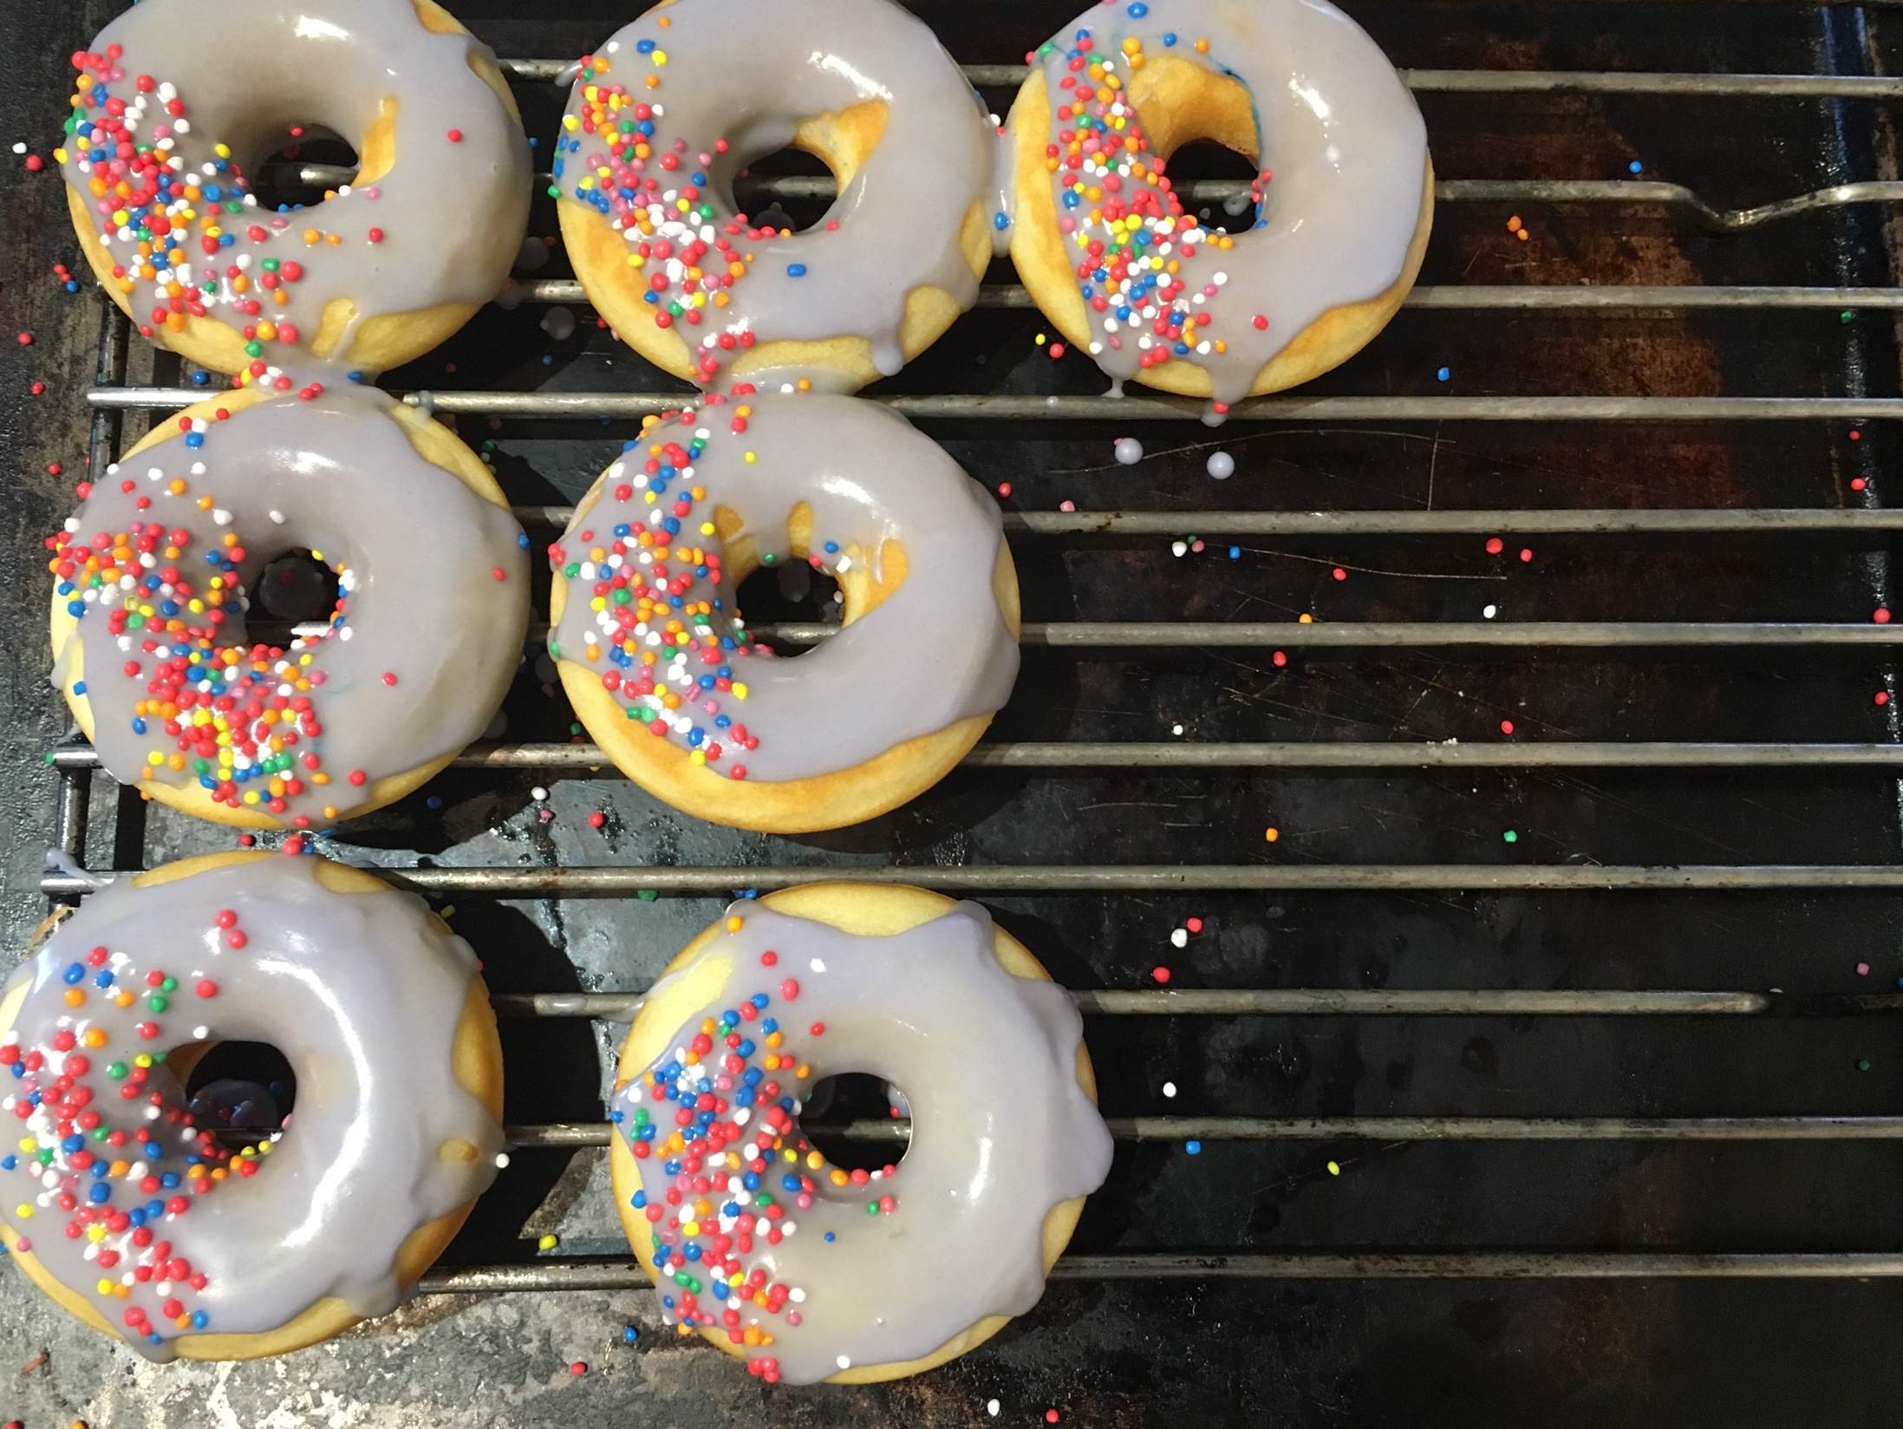

Slide 9
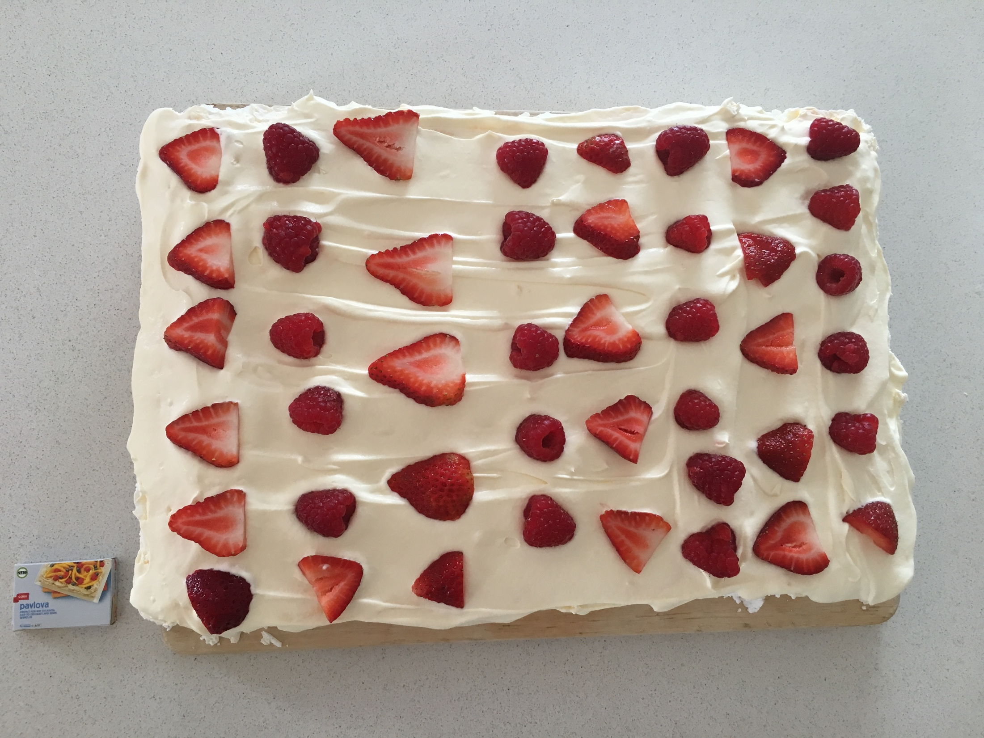

Slide 10
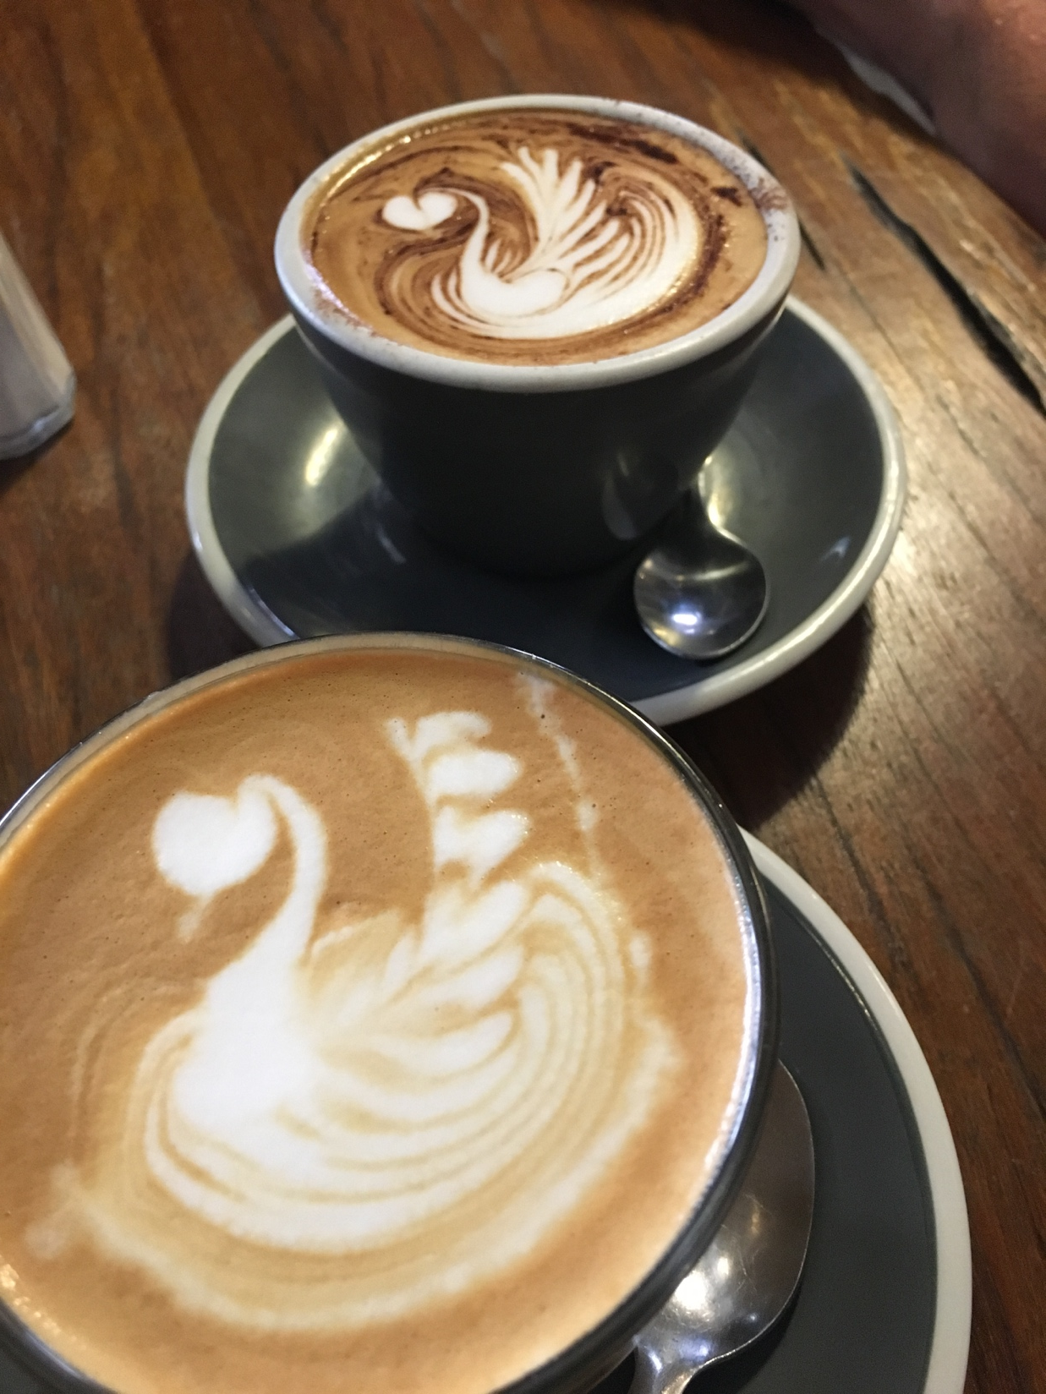

Slide 11
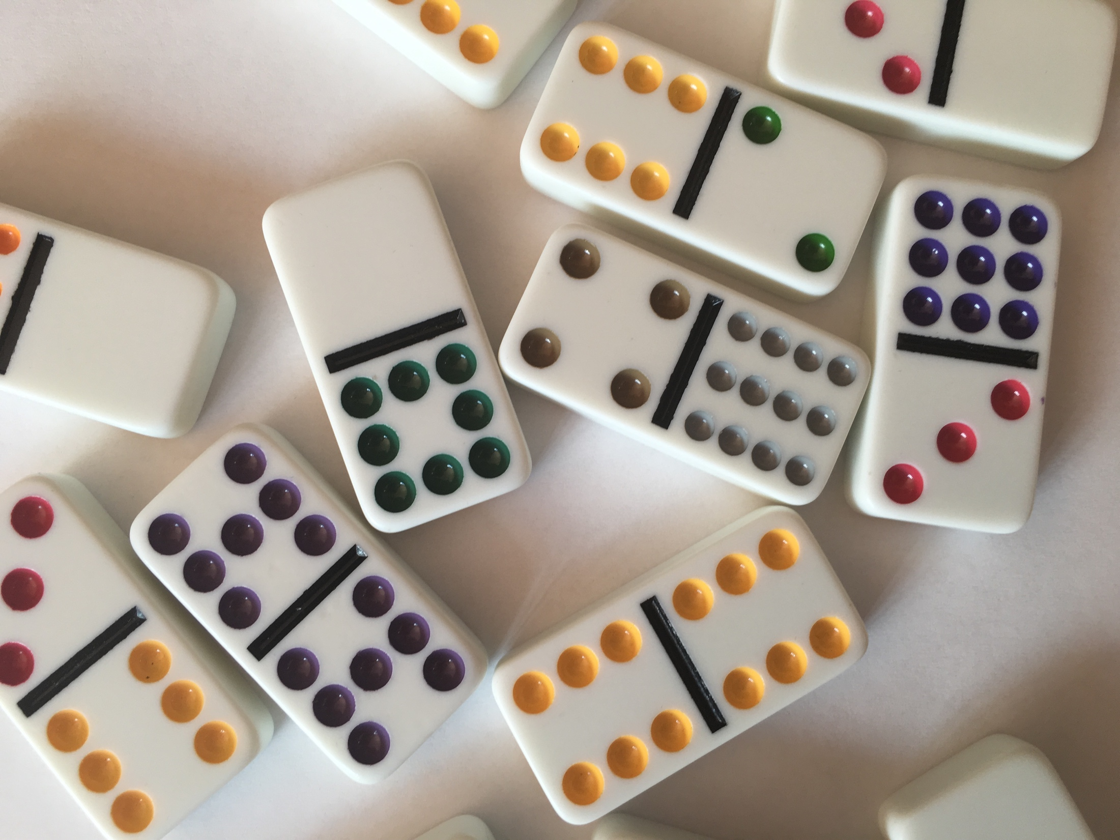

Slide 12
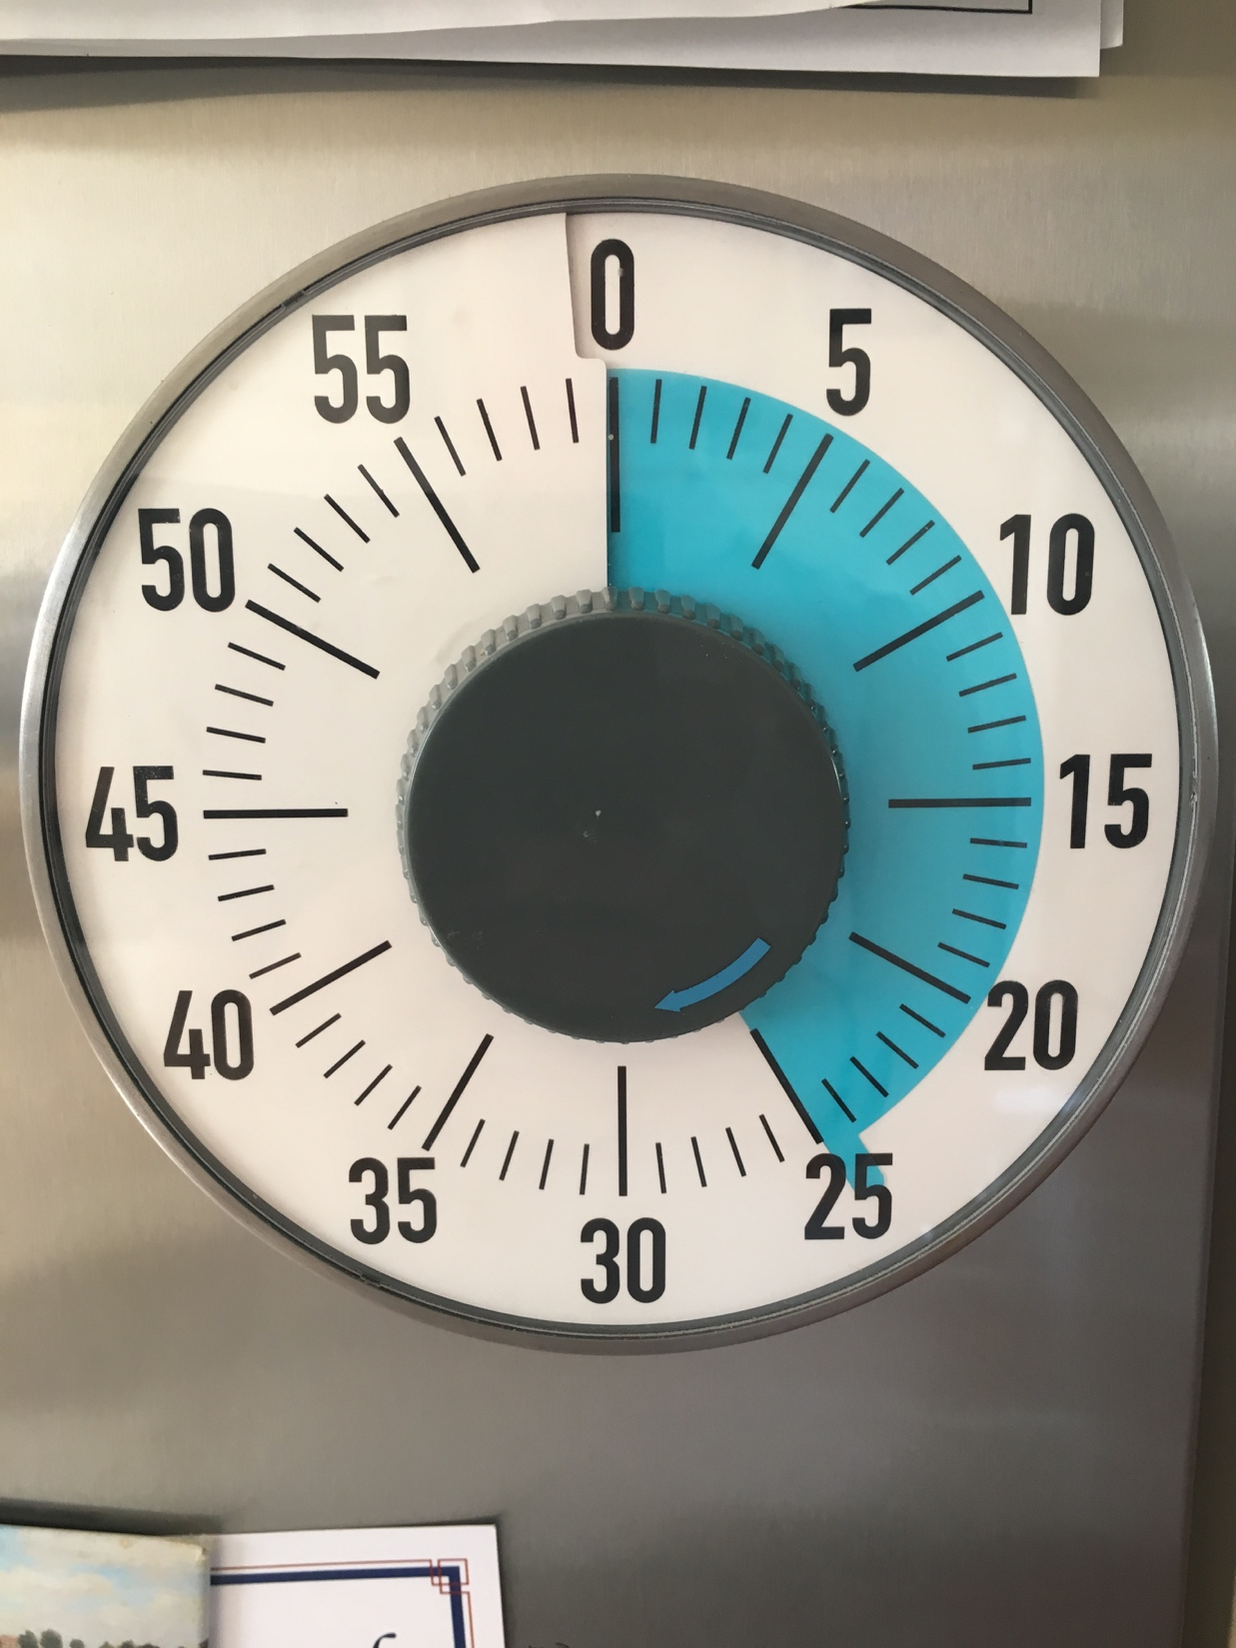

Slide 13
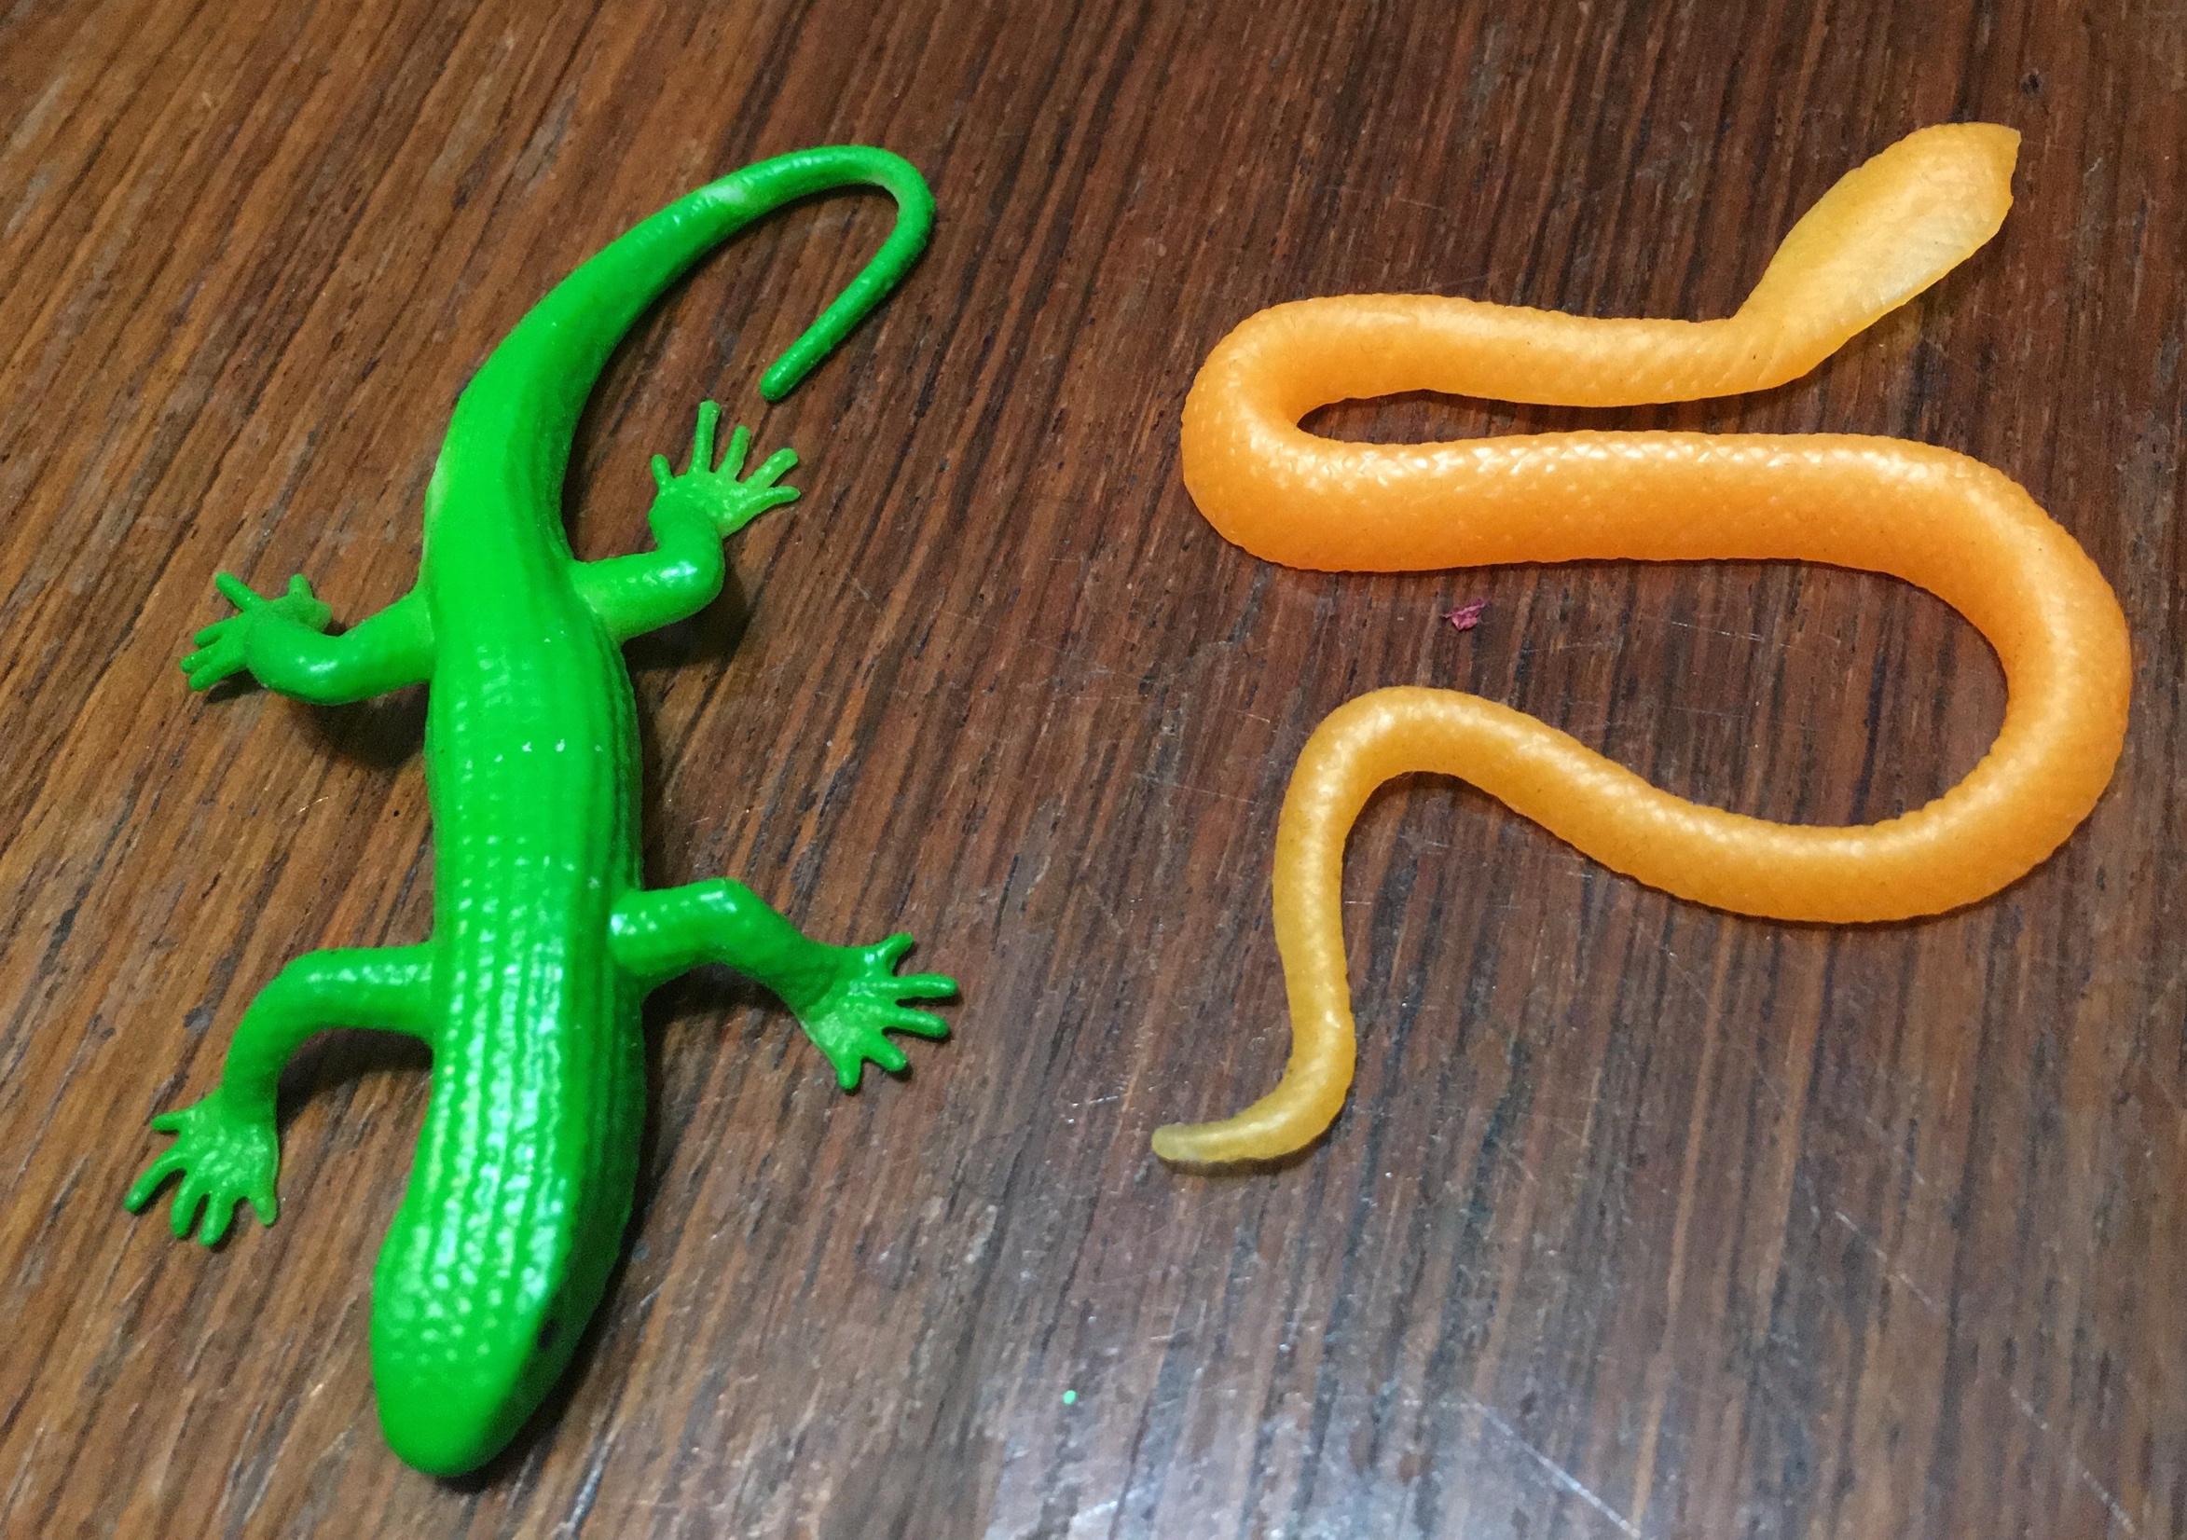

Slide 14
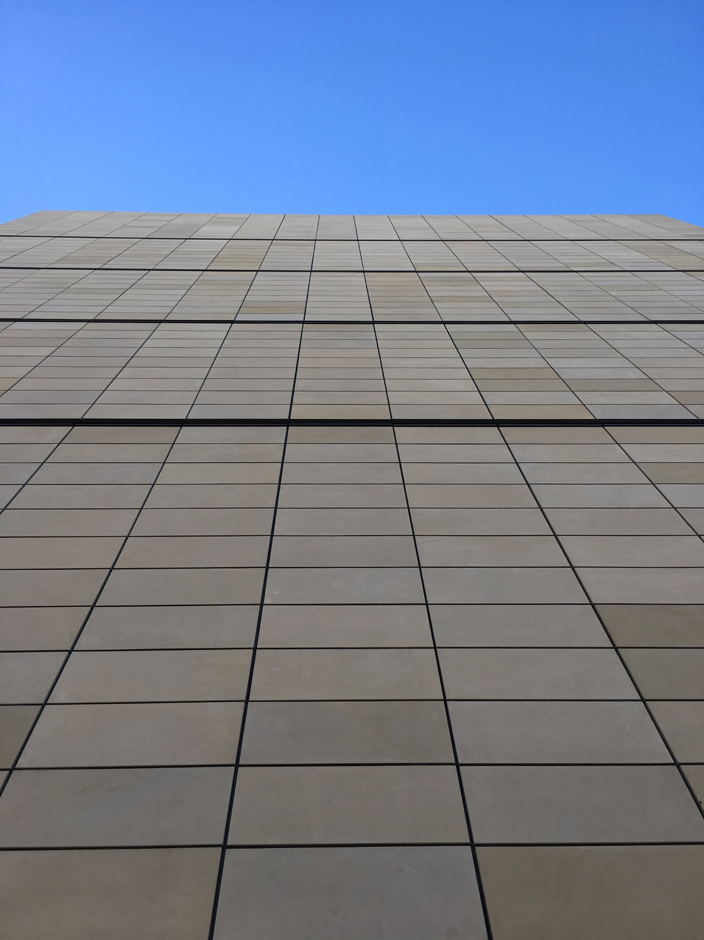

Slide 15
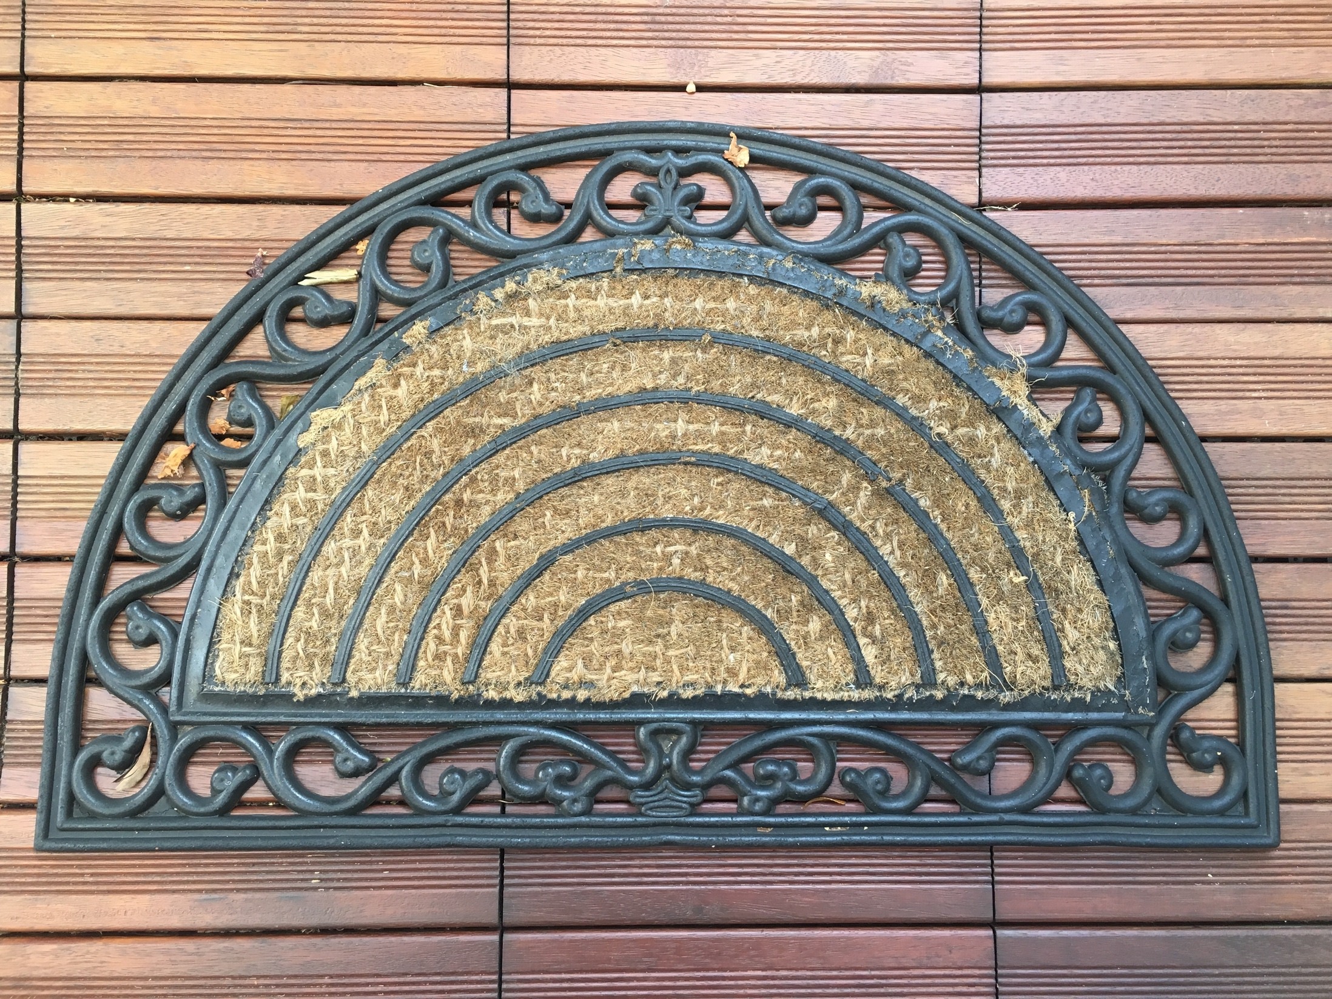

Slide 16
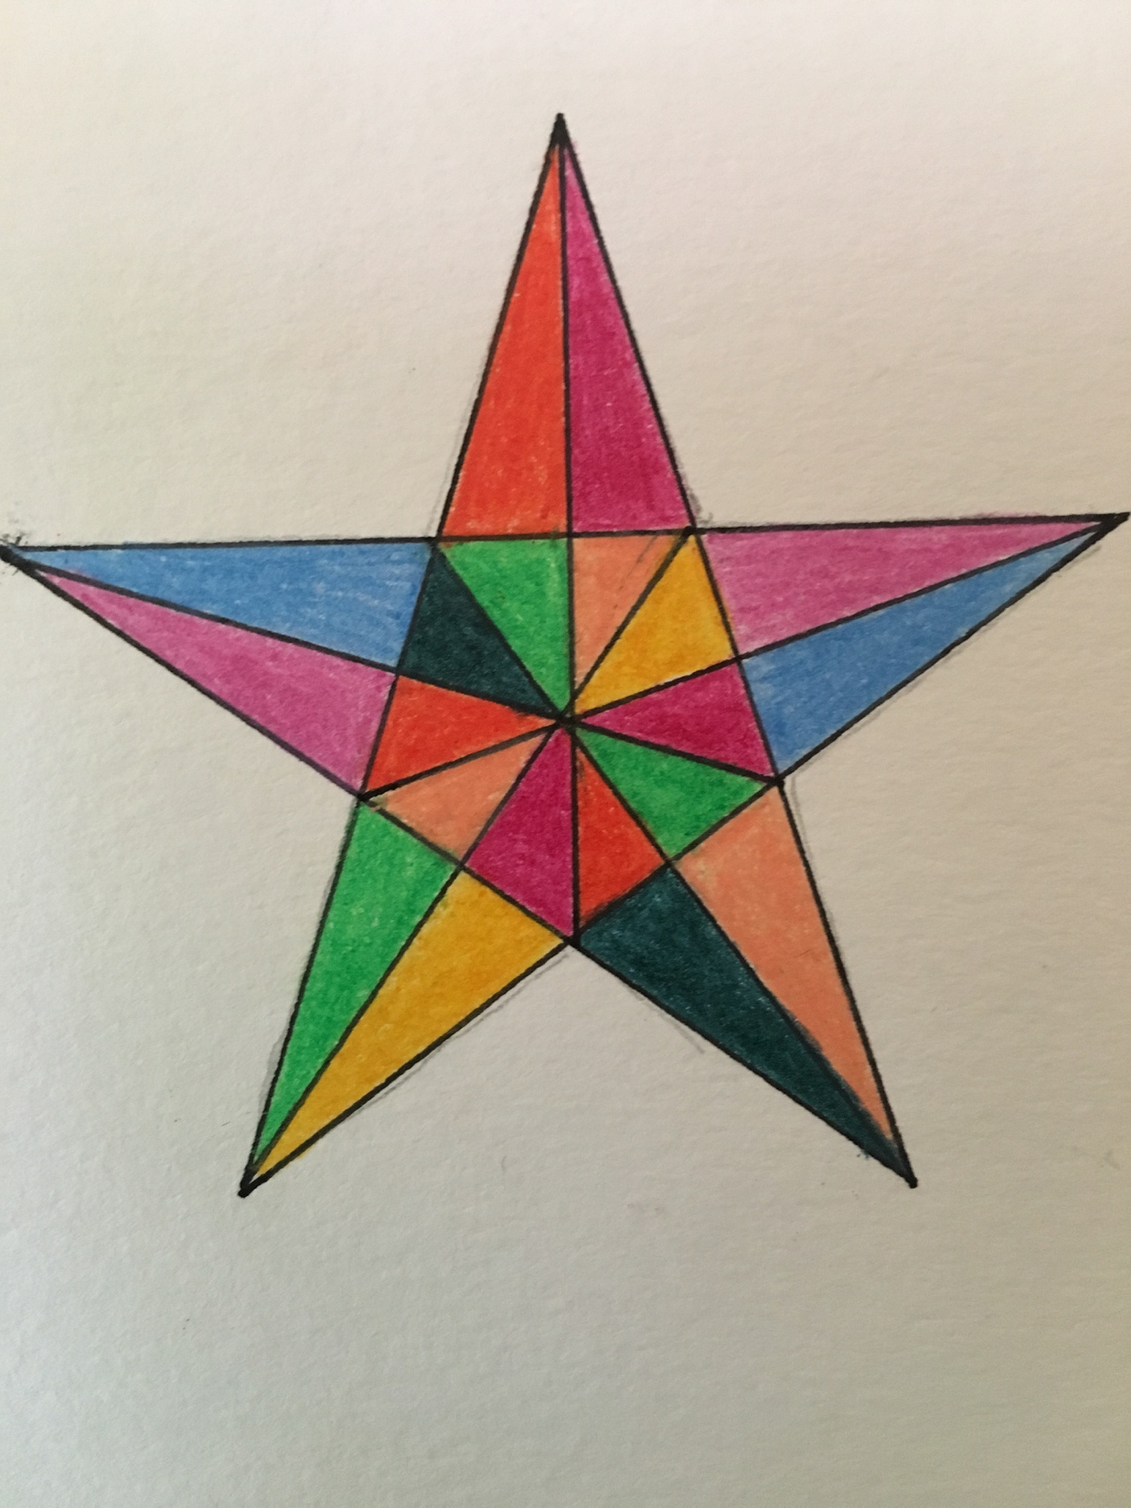

Slide 17
